Slide 1
Galaxy Morphology Classification
Team Members :
PRAJWAL A [PES1UG19CS334]
SAMMED T [PES1UG19CS426]
ANUSHA S RAO[PES1UG19CS077]

Slide 2
INTRODUCTION:
There are about 51 galaxies in the Local Group ,and in the order of 100,000 in our Local Supercluster, and an estimated 100 billion in all of the observable universe.
Galaxy morphological classification is a system used by astronomers to divide galaxies into groups based on their visual appearance. There are several schemes in use by which galaxies can be classified according to their morphologies
Dataset being used: Galaxy10 SDSS
Galaxy10 SDSS is a dataset contains 21785 69x69 pixels coloured galaxy images separated in 10 classes. Galaxy10 SDSS images come from Sloan Digital Sky Survey and labels come from Galaxy Zoo

Slide 3
BASE PAPER : D. Shaiakhmetov, R. R. Mekuria, R. Isaev and F. Unsal, "Morphological Classification of Galaxies Using SpinalNet," 2021 [ICECCO Conference]
Abstract :
The authors of the paper, with the idea of SpinalNet which was reported to have achieved in most of the DNNs they tested, not only a remarkable cut in the error but also in the large reduction of the computational costs. Have applied it to the Galaxy Zoo dataset.
They were able to classify the different classes and/or sub-classes of the galaxies , thus obtaining higher classification accuracies of 98.2 percent , between elliptical and spiral and 95 percents between the former and irregulars , and 82 between 10 sub-classes of galaxies.

Slide 4
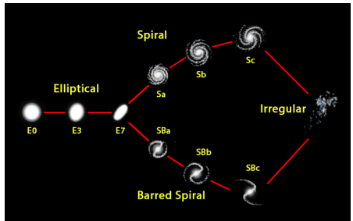
Hubble’s original classifications include
(i) elliptical galaxies: (E0, E1, E2, E3, E4, E5, E6, E7)
(ii) spirals (Sa, Sb, Sc), barred spiral (SBa, SBb, SBc) and
(iii) irregulars. [HUBBLE TUNNING FORK]
The paper focuses on 10-classes classifications namely, E0, E3, E7, Sa, Sb, Sc, SBa, SBb, SBc, Irregular
It outlines that having used SpinalNet which uses a DNN with a gradual input is an efficient technique for galaxy morphological (image) classifications

Slide 5
What Do we Focus on?
The base paper have achieved 82 percent accuracy on 10 sub-classes of galaxies.
We focus to increase this accuracy achieved and focus on 10-class classification of the dataset
Link to the base paper :
https://ieeexplore.ieee.org/abstract/document/9663784

Slide 6
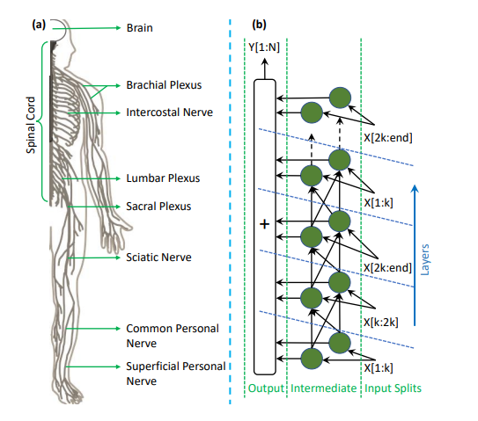
Paper 2: “SpinalNet: Deep Neural Network with Gradual Input” H M Dipu Kabir, Moloud Abdar, Seyed Mohammad Jafar Jalali, Abbas Khosravi, Senior Member, IEEE; Amir F Atiya, Senior Member, IEEE; Saeid Nahavandi, Fellow, IEEE; Dipti Srinivasan, Fellow, IEEE.
Link to paper: https://arxiv.org/abs/2007.03347

Slide 7
Abstract :
Deep neural networks (DNNs) with a step-by-step introduction of inputs, which is constructed by imitating the somatosensory system in human body, known as SpinalNet.
SpinalNet algorithm for example is an architecture which mimics the natural way of reacting.
It uses a unique way of connecting a large 9 number of sensing information and taking local decisions. One major drawback of feed-forward NN models is their computational intensiveness for large inputs
The Paper gives room to Researchers saying there is a chance to try to improve the accuracy of the proposed SpinalNet and apply the improved SpinalNet to a wide range of real-world scenarios.

Slide 8
PAPER 3: Nour Eldeen M. Khalifa1, ∗ , Mohamed Hamed N. Taha1, ∗ , Aboul Ella Hassanien1, ∗ , I. M. Selim ,“Deep Galaxy: Classification of Galaxies based on Deep Convolutional Neural Networks”, 2017
Abstract:
This Paper focuses on deep convolutional neural network architecture for galaxies classification.
It classifies galaxy based on its features into main three categories Elliptical, Spiral, and Irregular.
The proposed deep galaxies architecture consists of 8 layers, one main convolutional layer for features extraction with 96 filters, followed by two principles fully connected layers for classification.
It is trained over 1356 images and achieved 97.272% in testing accuracy.
A comparative result is made and the testing accuracy compared with other related works. The proposed architecture outperformed other related works in terms of testing accuracy.
Link to paper : https://arxiv.org/ftp/arxiv/papers/1709/1709.02245.pdf

Slide 9
PAPER 4: Shreyas Kalvankar, Hrushikesh Pandit, Pranav Parwate, “Galaxy Morphology Classification using EfficientNet Architectures”,2015
ABSTRACT :
The paper gives study on the usage of EfficientNets and their applications to Galaxy Morphology Classification.
It explore the usage of EfficientNets into predicting the vote fractions of the 79,975 testing images from the Galaxy Zoo 2 challenge on Kaggle.
Evaluation of the model is done using the standard competition metric i.e, rmse score and rank among the top 3 on the public leaderboard with a public score of 0.07765.
Paper proposes a fine-tuned architecture using EfficientNetB5 to classify galaxies into seven classes - completely round smooth, in-between smooth, cigarshaped smooth, lenticular, barred spiral, unbarred spiral and irregular.
The network along with other popular convolutional networks are used to classify 29,941 galaxy images.
Different metrics such as accuracy, recall, precision, F1 score are used to evaluate the performance of the model along with a comparative study of other state of the art convolutional models to determine which one performs the best.
an accuracy of 93.7% was obtained on classification model with an F1 score of 0.8857. EfficientNets can be applied to large scale galaxy classification in future optical space surveys which will provide a large amount of data such as the Large Synoptic Space Telescope.

Slide 10
PAPER 5: A. Schutter, L. Shamir “Galaxy morphology — An unsupervised machine learning approach”,2015
The paper proposes a computer-based approach to galaxy morphology by using an unsupervised machine learning system that can deduce the visual similarities between sets of images and reconstruct morphological sequences of galaxies.
The analysis is performed such that the algorithm determines the network of similarities between the different morphological classes automatically, and without human guidance.
Link to paper: https://sci-hub.hkvisa.net/10.1016/j.ascom.2015.05.002

Slide 11
THANK YOU

Slide 12
Galaxy10 SDSS is a dataset contains 21785 69x69 pixels colored galaxy images (g, r and i band) separated in 10 classes. Galaxy10 SDSS images come from Sloan Digital Sky Survey and labels come from Galaxy Zoo.
https://astronn.readthedocs.io/en/latest/galaxy10sdss.html
https://arxiv.org/ftp/arxiv/papers/1709/1709.02245.pdf
https://www.kaggle.com/tenzinmigmar/galaxy-multi-image-classification-with-lenet-5#Galaxy10-Dataset
https://medium.com/analytics-vidhya/multiclass-image-classification-problem-convolutional-neural-network-trains-on-galaxy-images-6ca6aa74e5d7

